Slide 1
An NLP Primer for Library Technologists
Corey A Harper – @chrpr Presented at code4lib 2017 Los Angeles – March 8, 2017

Slide 2
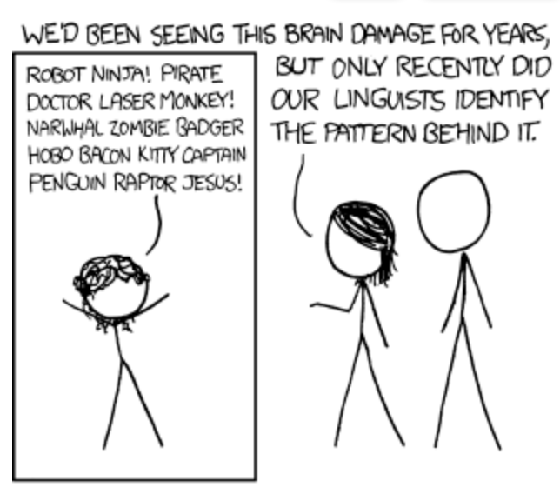
Table of contents
Machine Learning Background
Computational Linguistics & NLP
Neural Nets & Vector Embeddings
DPLA Experimentation
Use cases in for code4libbers
https://xkcd.com/856/

Slide 3
Machine Learning
Netflix Prize (2009)
Entirely based on ratings
Collaborative Filtering
Matrix Factorization
Classification, clustering, info extraction, summarization, translation, and more
Importance of Feature Engineering

Slide 4
Matrix factorization
 | … | … | … | … | … | Gillian Welch | … | … | …
… | 0 | 0 | 0 | 0 | 0 | 0 | 2 | 0 | 0
… | 0 | 0 | 1 | 0 | 1 | 4 | 0 | 0 | 1
… | 0 | 0 | 0 | 2 | 0 | 0 | 0 | 0 | 0
… | 1 | 0 | 1 | 0 | 1 | 0 | 1 | 0 | 1
… | 0 | 0 | 1 | 0 | 3 | 0 | 0 | 0 | 0
Corey | 0 | 1 | 0 | 0 | 0 | 7 | 0 | 2 | 1
… | 0 | 0 | 0 | 0 | 0 | 0 | 0 | 0 | 0
... | 0 | 0 | 1 | 1 | 0 | 1 | 1 | 0 | 0
… | 0 | 3 | 0 | 0 | 3 | 0 | 0 | 0 | 0

Slide 5
Matrix Factorization (cont)
Hu, Y., Koren,Y. & & Volinsky, C.
“Collaborative Filtering for Implicit Feedback Datasets”
http://yifanhu.net/PUB/cf.pdf
Huge, sparse pairwise user/item matrices
Decomposed into a pair of dense matrices
One for users, one for items
Mapped into a “common latent factor space” *
Dot Product of user & item vector can estimate the point in those dense matrices
Notes:
Incidentally, Chris Volinsky won that netflix prize I mentioned earlier…

Slide 6
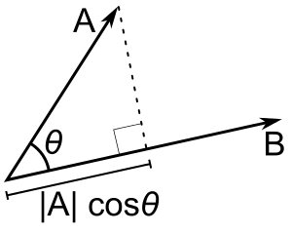
(first) math interlude
e
cos(θ)
http://blog.christianperone.com/2013/09/machine-learning-cosine-similarity-for-vector-space-models-part-iii/
Notes:
Some ”vector similarity” measures:
Dot Product: a scalar value represents the projection of one vector onto another.
Cosine Similarity: a measure of the angle between two vectors. No accounting magnitude.
Euclidian Distance:

Slide 7
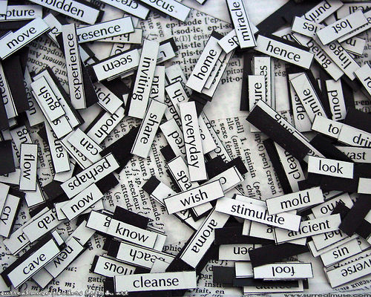
Text Features & Vectorization
https://www.flickr.com/photos/surrealmuse/4757004
Bag of Words (BOW)
(TF-IDF) Term Frequency – Inverse Doc Frequency
Part of Speech Information
Probabilistic Models

Slide 8
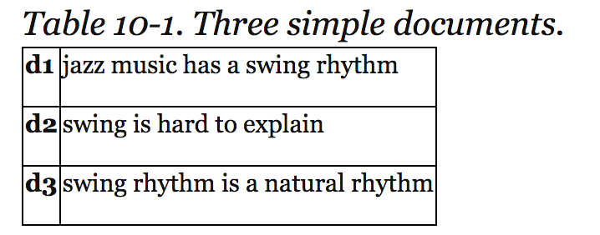
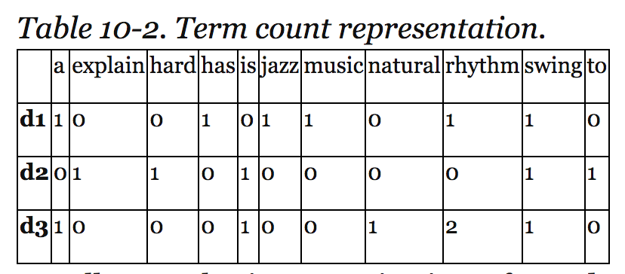
Bag of Words Example
Tables from: Provost, F., & Fawcett, T. (2013). Data science for business.
Sebastopol, CA: O'Reilly.
Many uses in ML applications
Spam Filters
Relevancy Ranking
Recommender Systems

Slide 9
More Latent Features
http://fastml.com/bayesian-machine-learning/
http://cs.stanford.edu/~ppasupat/a9online/1140.html
Latent Semantic [Indexing (LSI) | Analysis (LSA)]
Latent Dirichlet Allocation
Related to Matrix Factorization
Docs/Topics matrix and Topics/Words matrix
Probabilistic and Non-deterministic

Slide 10
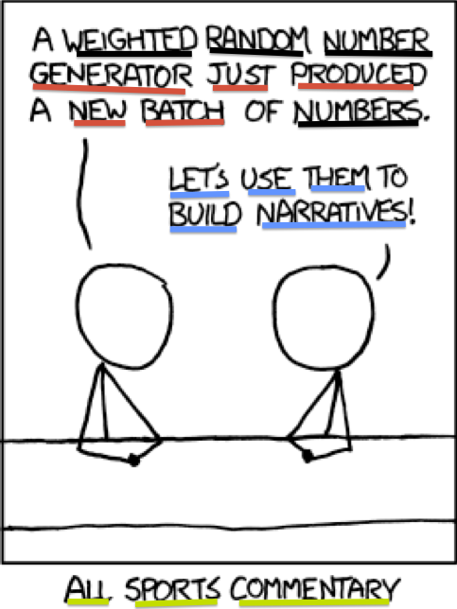
http://cpsievert.github.io/projects/615/xkcd/
Red = Romance (.29)
Blue = Sarcasm (.29)
Black = Math (.24)
Green = Language (.18)

Slide 11
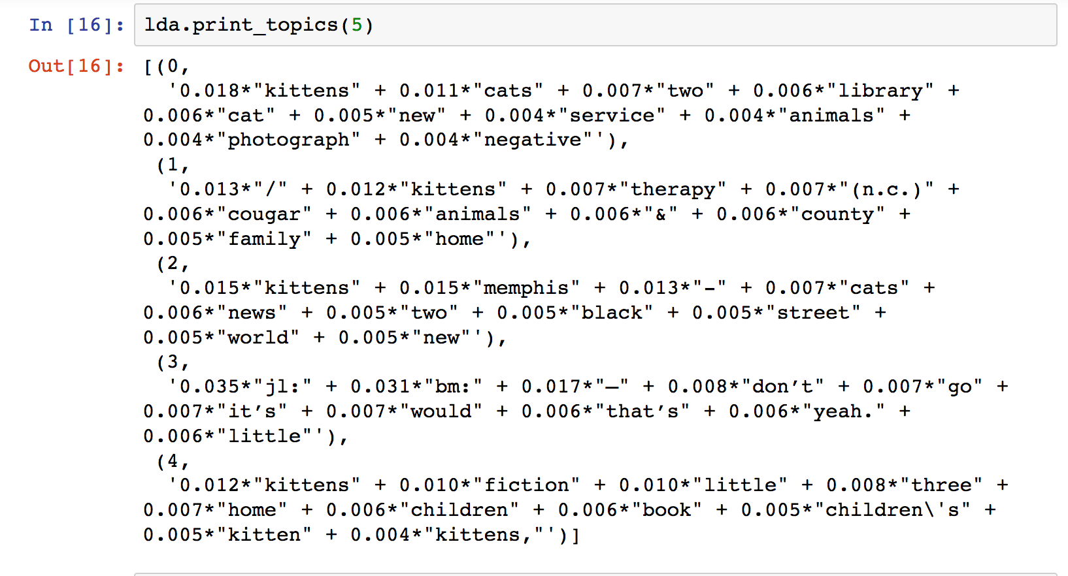
393 DPLA Kittens

Slide 13


Slide 14
Deep Learning
In and out of style for decades.
3rd, maybe 4th, “Summer of Neural Networks”
Many different types
Convolutional Neural Networks:
Only pass values forward
Great results for machine vision

Slide 15
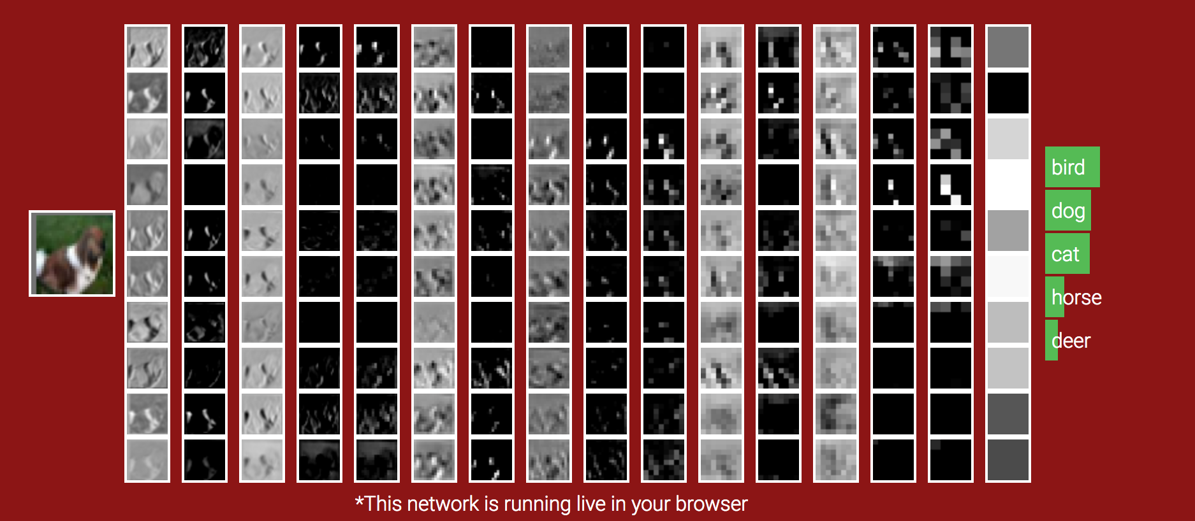
Source: http://cs231n.stanford.edu/
Information: http://cs.stanford.edu/people/karpathy/convnetjs/

Slide 16
Word2vec
https://arxiv.org/pdf/1301.3781.pdf
Applying Neural Networks (specifically Feed Forward and Recurrent Nets) to NLP
Continuous Bag of Words (CBOW)
Predicting current word based on neighbors
Continuous skipgram
Predicting context based on current word

Slide 17
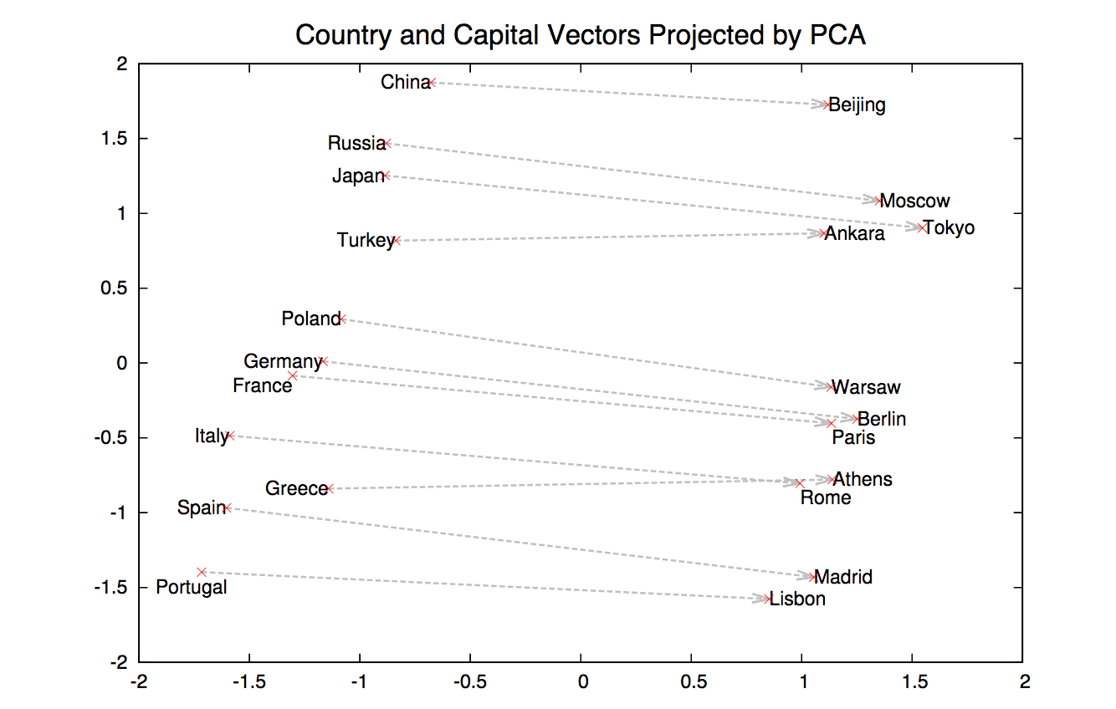
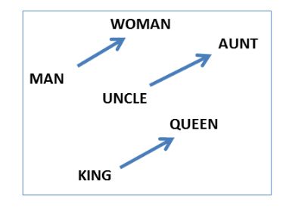
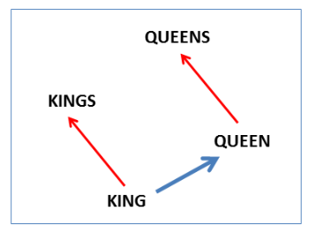
Word2vec Examples
https://papers.nips.cc/paper/5021-distributed-representations-of-words-and-phrases-and-their-compositionality.pdf
http://msr-waypoint.com/en-us/um/people/gzweig/Pubs/NAACL2013Regularities.pdf

Slide 18
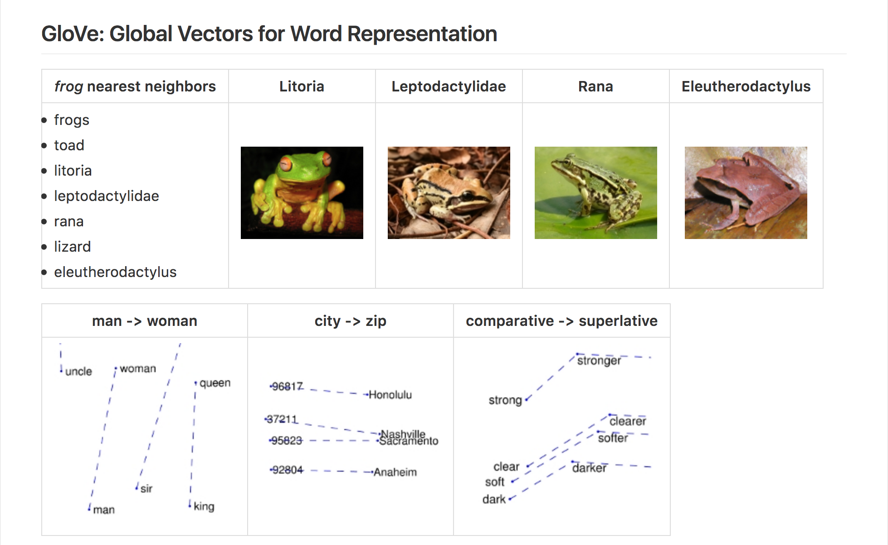
https://github.com/stanfordnlp/GloVe

Slide 19
IHeartRadio Example
Remember earlier matrix factorization
They implemented word2vec on top
Expanded entities to include:
Genres
Instruments
Female/Male vocalists

Slide 20
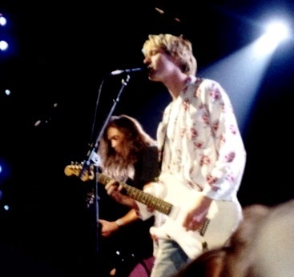


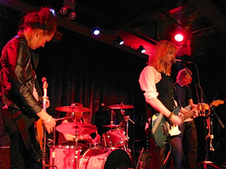
Example from: https://docs.google.com/presentation/d/1S5Cizi9LFQ7l0bMYtY7gASvOPqxNsQk0-NuP5KWAl-4/pub
Images from: http://www.clker.com & https://www.wikipedia.org/

Slide 21
DPLA Vectors & Twitter
“Will conclude with a demonstration of attempts to use Twitter profiles and recent tweets to build a search vector for querying DPLA according to vector cosine similarity and nearest neighbor algorithms.”

Slide 22
Failed Attempts
Still not working
Various vectors tried:
Gensim Doc2vec (Skip Thoughts)
GLoVe with Global Vectors
GLoVe w/ DPLA specific vectors
Code and data if others want to play

Slide 23
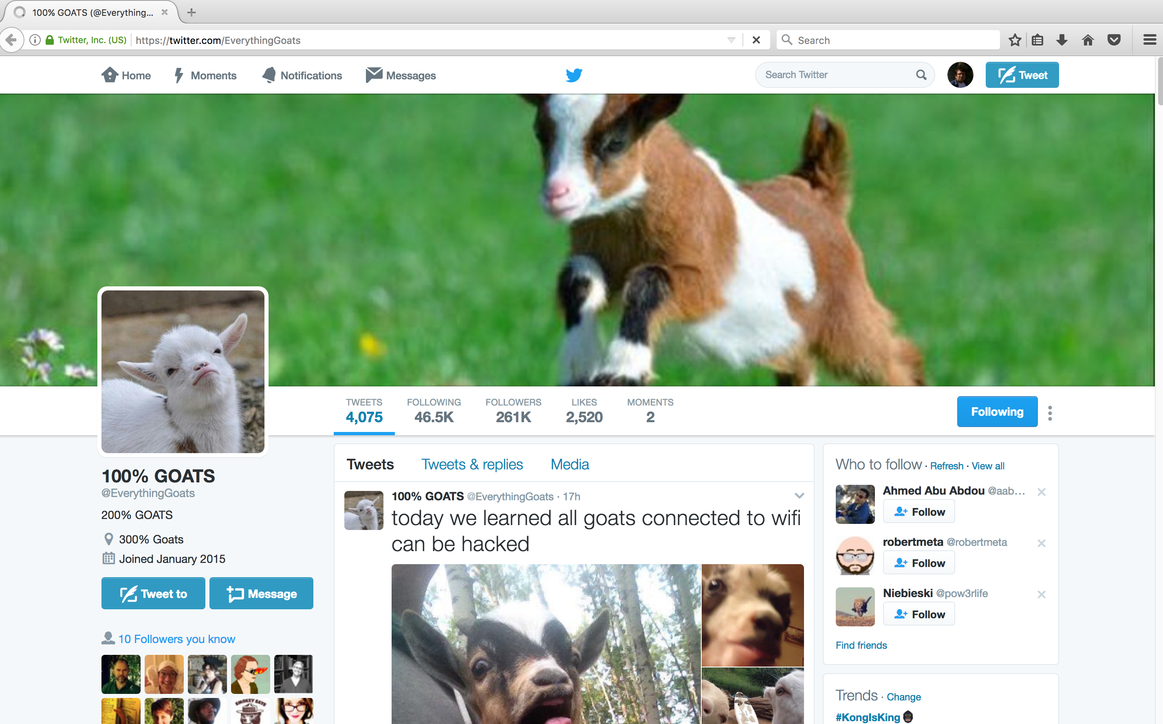

Slide 24
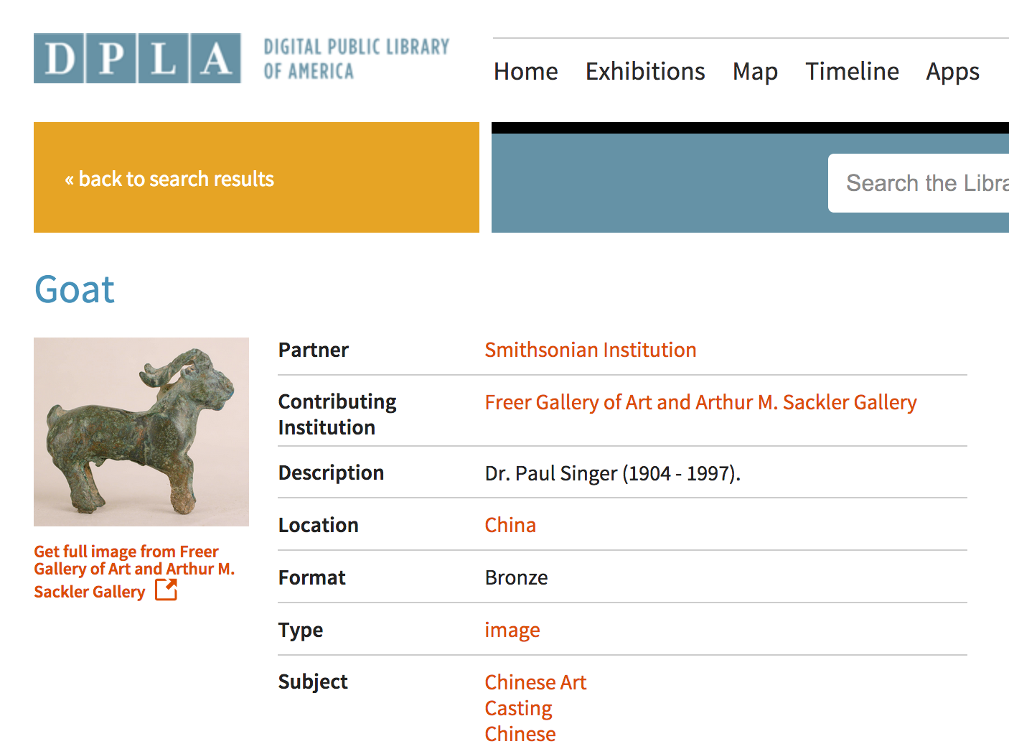

Slide 25
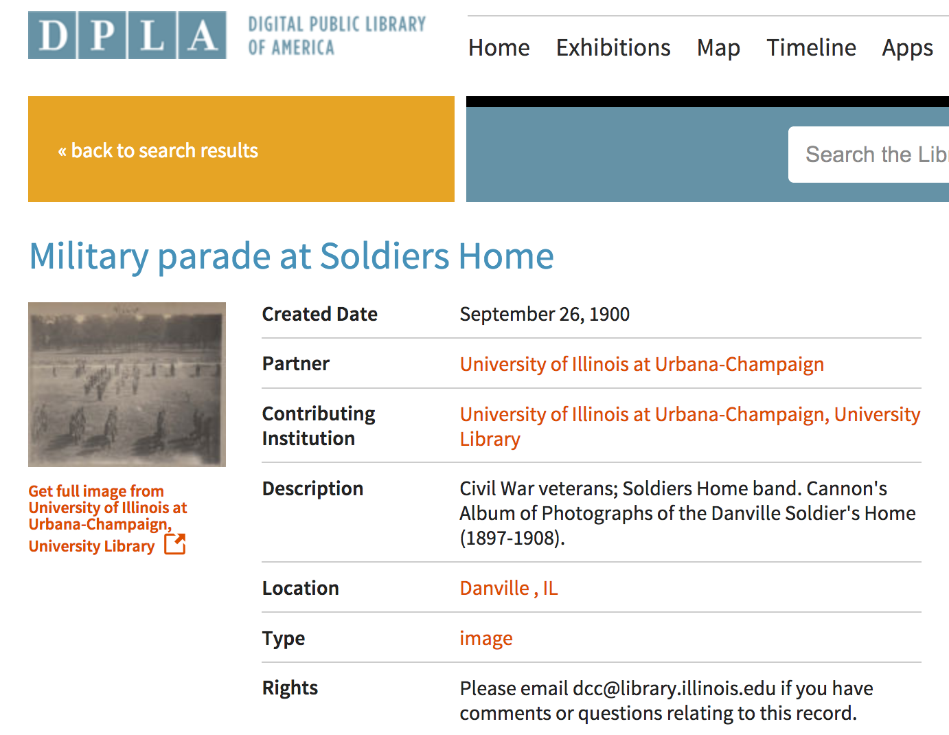

Slide 26
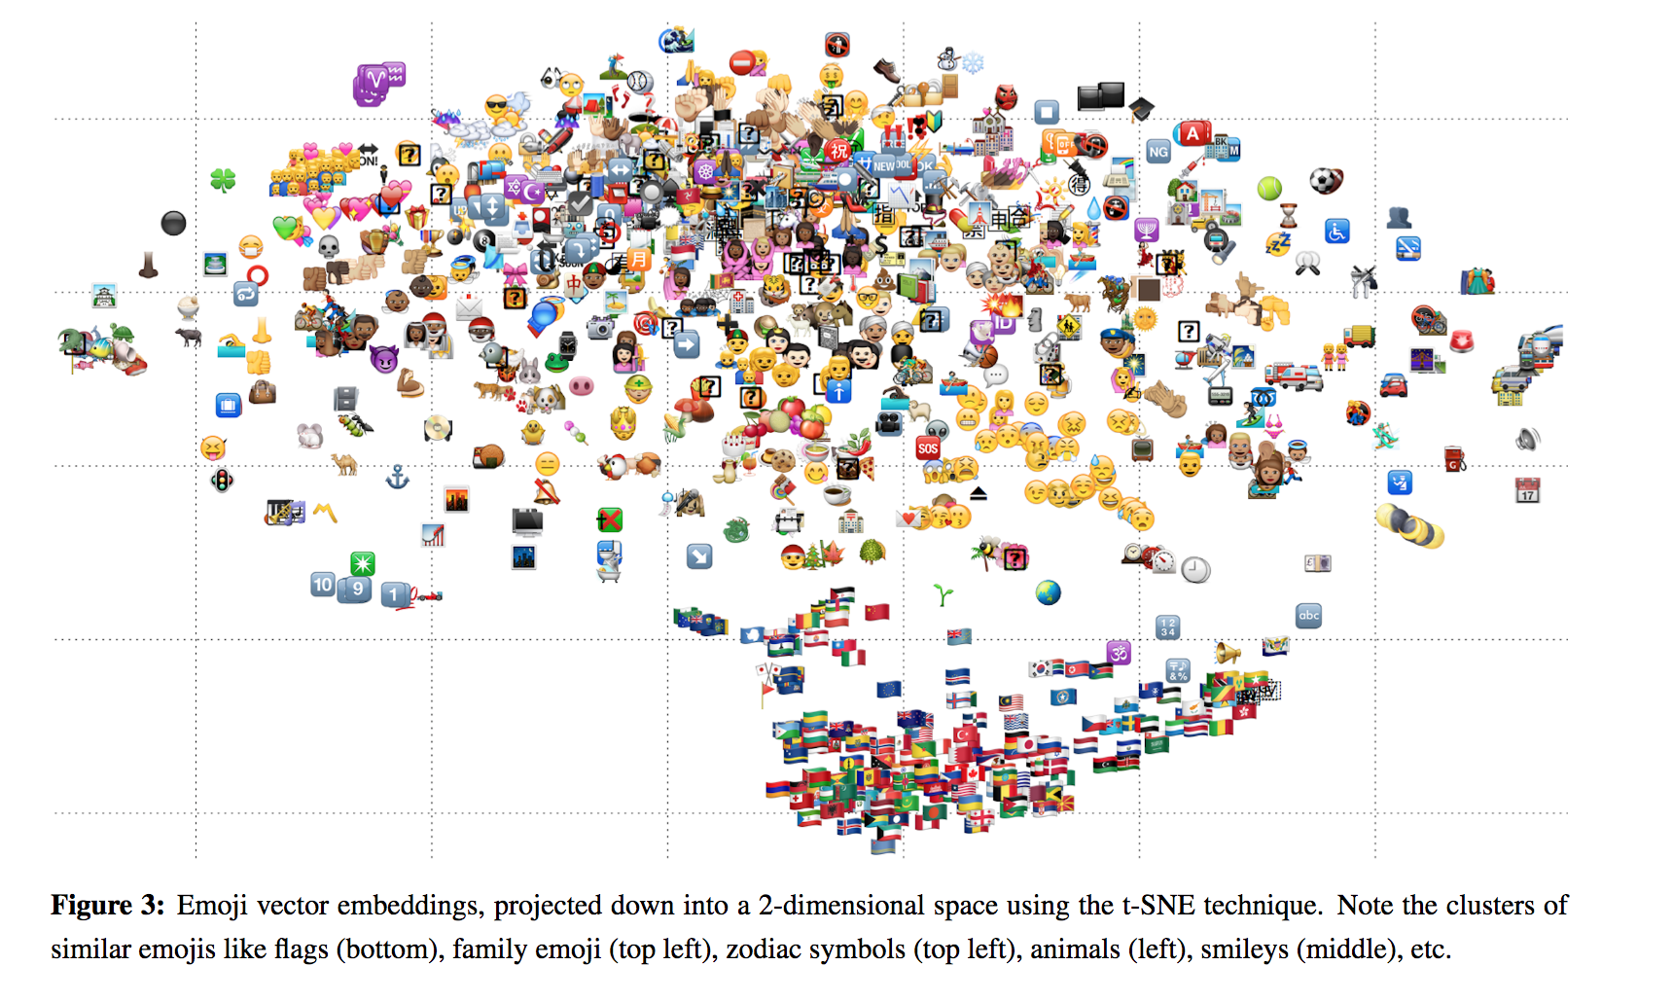
https://en.wikipedia.org/wiki/T-distributed_stochastic_neighbor_embedding
https://arxiv.org/pdf/1609.08359.pdf

Slide 27
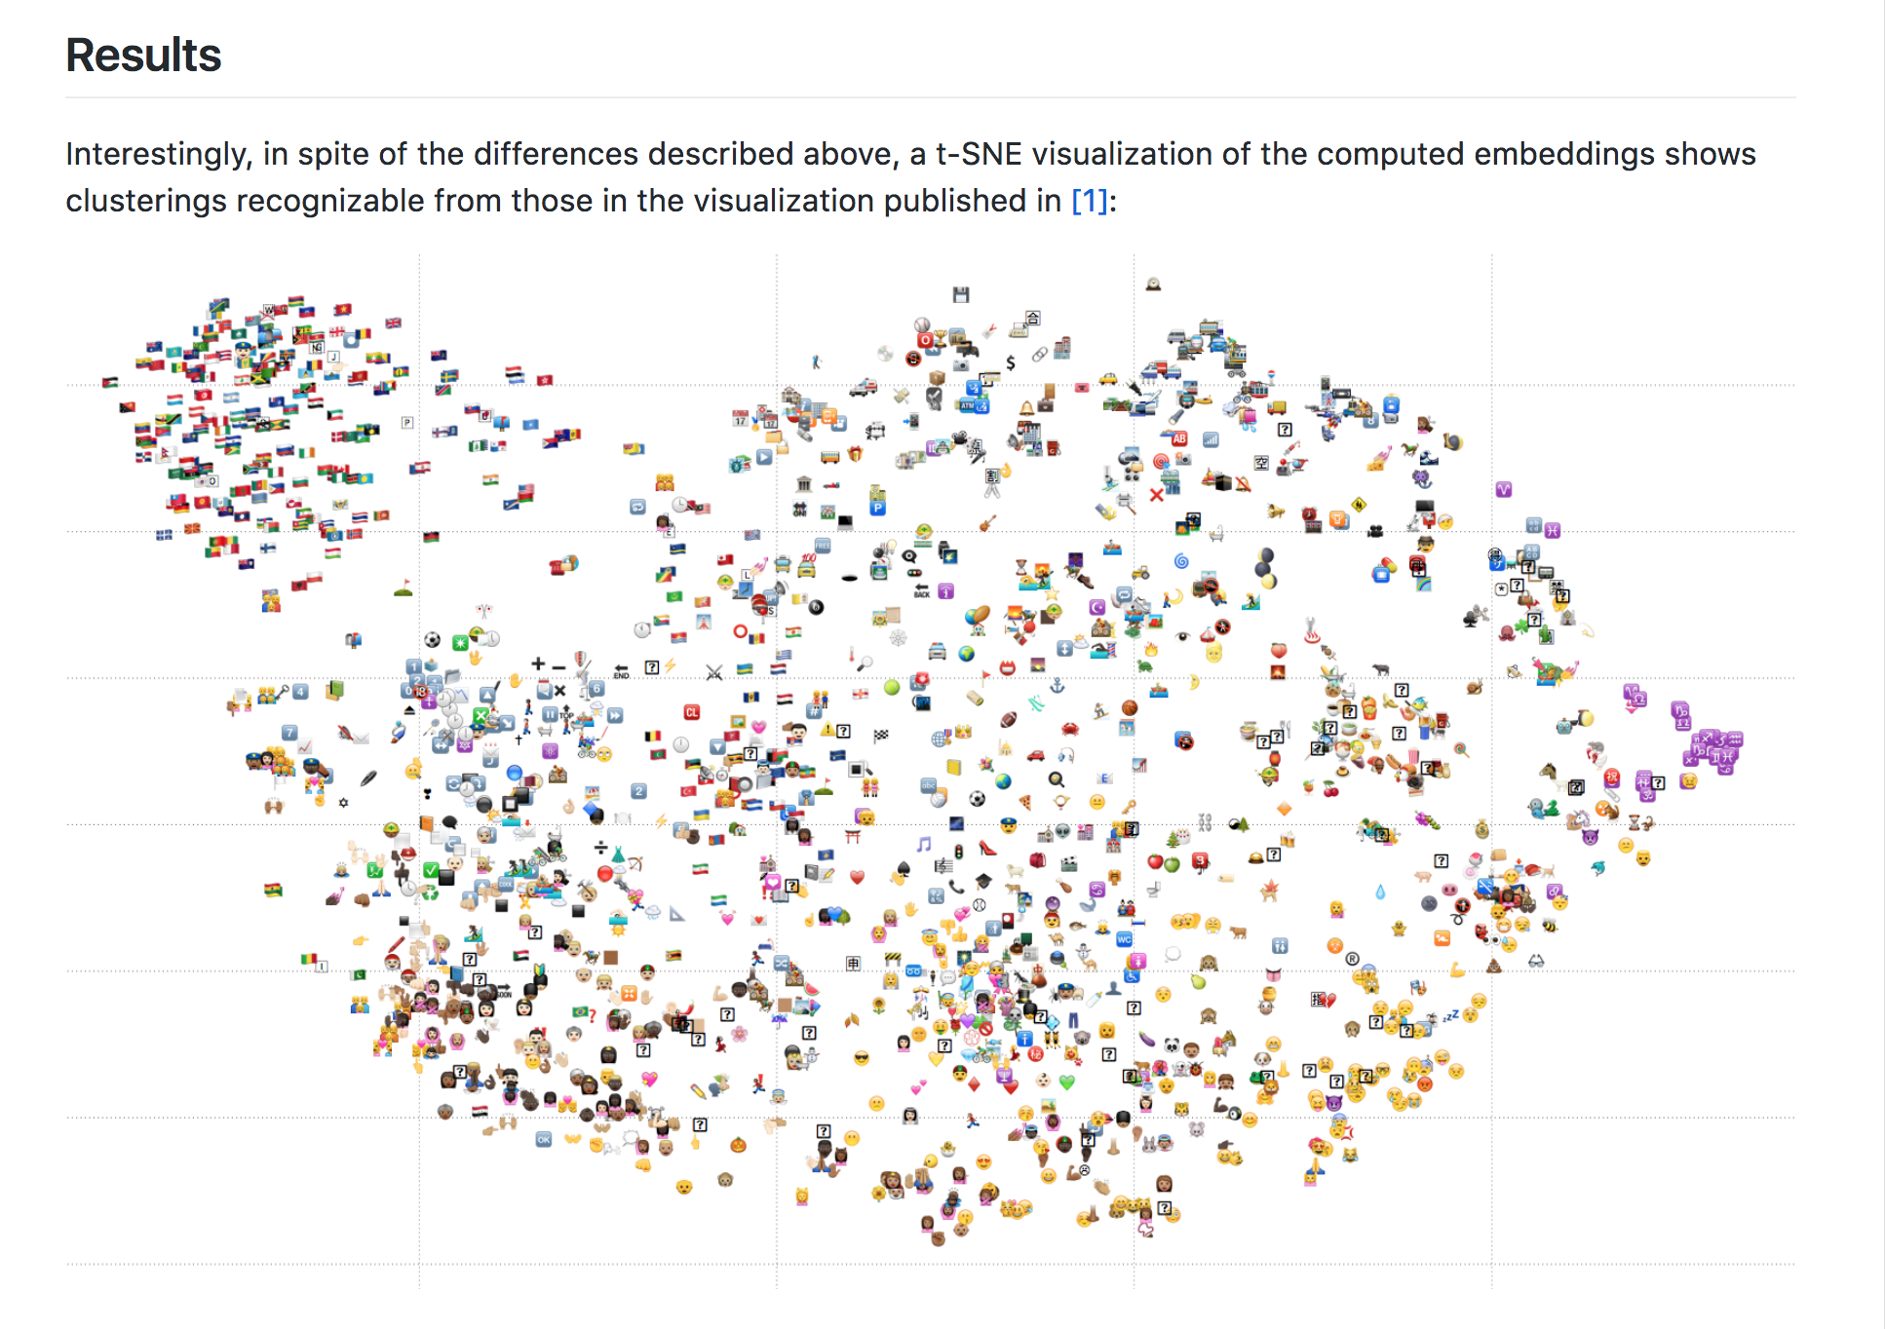
Comparable t-SNE from a Keras-based implementation
https://github.com/bradleypallen/keras-emoji-embeddings

Slide 28
Natural Language Processing
In Science, Technology, and Medicine
Continuing Harper code4lib 2017 2017-03-08 @chrpr

Slide 29
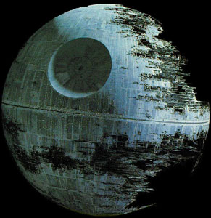

Get it out of your system now…
I’ll wait…
Okay, back to our content:
Knowledge Graph Extraction
Units & measurement
Citing sentences
Protocols and Methods
Molecular compounds
Etc.
Image source: https://en.wikipedia.org/wiki/Death_Star
With elephant from: https://clipartfest.com/download/96e1647287539546d10216ab30ffcbda2460067d.html
Notes:
So with 5 minutes left, I’m finally going to address the elephant in the death star (where a number of you now think I work…)

Slide 30
Use Cases
Recommendation systems
Document Classification
Controlled Vocab Assignment
Document (and Multi-Document) Summarization
for current trends / awareness / etc
Knowledge Graph Extraction
Question answering systems
Decision support systems

